Slide 1
MBD-Chip

Slide 2
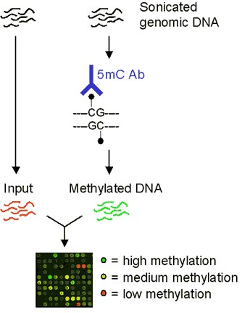
Workflow: Identify methylated regions

Slide 3
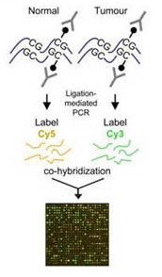
Workflow: differential methylation

Slide 4
Oyster DNA Tiling Array
3 x 720k design
Each feature ~100bp x 720k feature =72Mb for the microarray
720k
720k
720k
Notes:
Genome is about 600Mb so needed to reduce it..

Slide 5
methylation changes in response to EE2
Day 7
Control Pool: 3 females
EE2 Pool: 3 females
Pooled MBD (n=3)
Input
EE2: red
cntrl: green
EE2: green
cntrl: red
EE2: green
cntrl: red

Slide 6
methylation changes in response to EE2
Day 7
Control Pool: 3 females
EE2 Pool: 3 females
Pooled MBD (n=3)
Input
EE2: red
cntrl: green
EE2: green
cntrl: red
EE2: green
cntrl: red

Slide 7
Analysis:
Microarray people at Fred Hutch were not a big fan of the assay design
They think the MBD v. input is more robust
Note that this MBD v. MBD approach may introduce more bias (from random fragmenting; PCR)
Suggest using the classic design for future assays

Slide 8
Analysis:
Bioconductor package, "Ringo” used for analysis
* Read NimbleGen pair files into R
* Remove control probes
* Tukey biweight mean center log2 ratios within each array (all ratios were formulated such that the estrogen treated sample is always in the numerator)
* Smooth log2 ratio values by computing a running median, using a window size of 1000 bases
* Within each array, use the log2 ratio distribution to calculate the threshold to be used for peak detection, then detect peaks such that at least 3 adjacent probes must be above threshold.
* Identify the overlap between A02 and A03, excluding A01 using the Bioconductor package "ChIPpeakAnno."

Slide 9
Analysis:
Region 1
Region 2
Region 3
EE2 v C
C v EE2
input v input

Slide 10
Results:
96 regions that were hypermethylated in EE2
90 are in genes
52 of these cross exon/intron boundary another
32 are in introns
6 are just in exons
287 regions that were hypomethylated in EE2
256 are in genes
138 cross exon/intron boundary
114 are in introns only and
4 are just in exons

Slide 11
Functional enrichment analysis hypermethylated in EE2 treatment

Slide 12
Functional enrichment analysis hypomethylated in EE2 treatment

Slide 13
Next Steps
Validation:
Use targeted bisulfite sequencing to validate differentially methylated regions
Issues:
How to pick targets for validation? (most interesting, most different?)
Tissue availability
Can only validate on 2 of the 3 individuals for the EE2 sample
Additional arrays? (exp date, reusing array)

